Slide 1



T20 Playing 11
View in Power BI
Last data refresh:
2/27/2023 12:38:37 AM UTC
Downloaded at:
2/27/2023 12:46:32 AM UTC

Slide 2
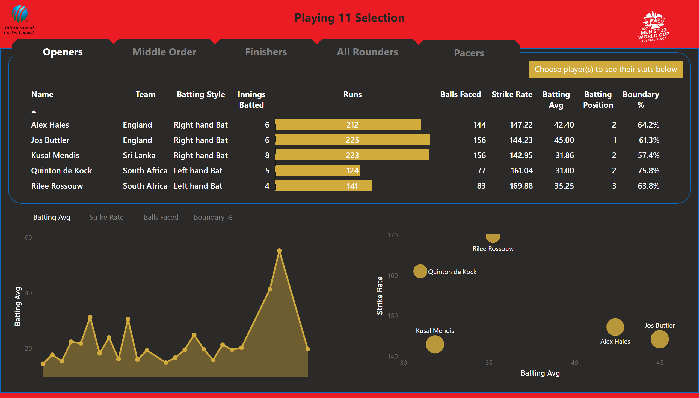
Openers
Notes:
tableEx
No alt text provided
scatterChart
No alt text provided
Batting Avg
No alt text provided
areaChart
No alt text provided
areaChart
No alt text provided
areaChart
No alt text provided
shape
No alt text provided
shape
No alt text provided
actionButton
No alt text provided
actionButton
No alt text provided
actionButton
No alt text provided
actionButton
No alt text provided
actionButton
No alt text provided
textbox
No alt text provided
Batting Avg
No alt text provided
actionButton
No alt text provided
actionButton
No alt text provided
actionButton
No alt text provided
Batting Avg
No alt text provided
Strike Rate
No alt text provided
Balls Faced
No alt text provided
Boundary %
No alt text provided
image
No alt text provided
image
No alt text provided
textbox
No alt text provided

Slide 3
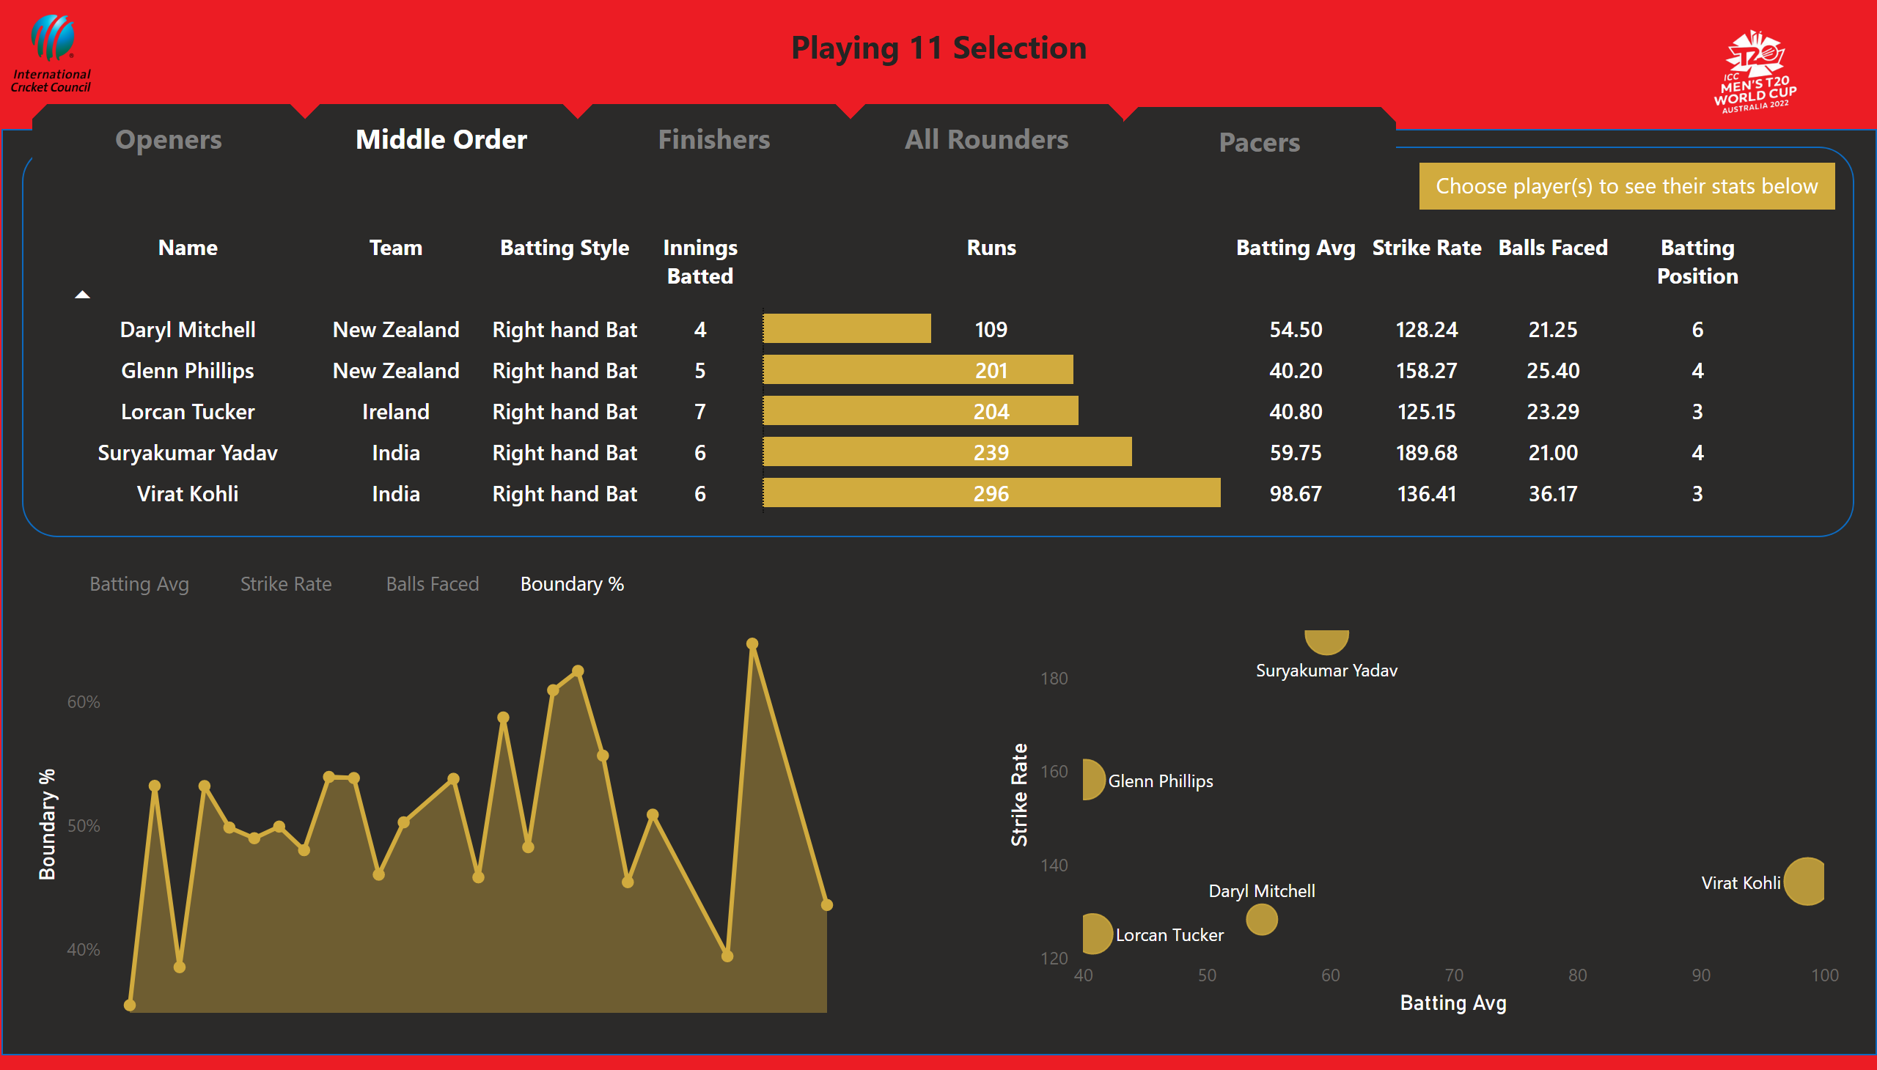
Middle Order
Notes:
tableEx
No alt text provided
scatterChart
No alt text provided
areaChart
No alt text provided
Boundary %
No alt text provided
areaChart
No alt text provided
areaChart
No alt text provided
shape
No alt text provided
shape
No alt text provided
actionButton
No alt text provided
actionButton
No alt text provided
actionButton
No alt text provided
actionButton
No alt text provided
actionButton
No alt text provided
textbox
No alt text provided
actionButton
No alt text provided
actionButton
No alt text provided
actionButton
No alt text provided
Boundary %
No alt text provided
Batting Avg
No alt text provided
Strike Rate
No alt text provided
Balls Faced
No alt text provided
Boundary %
No alt text provided
image
No alt text provided
image
No alt text provided
textbox
No alt text provided

Slide 4
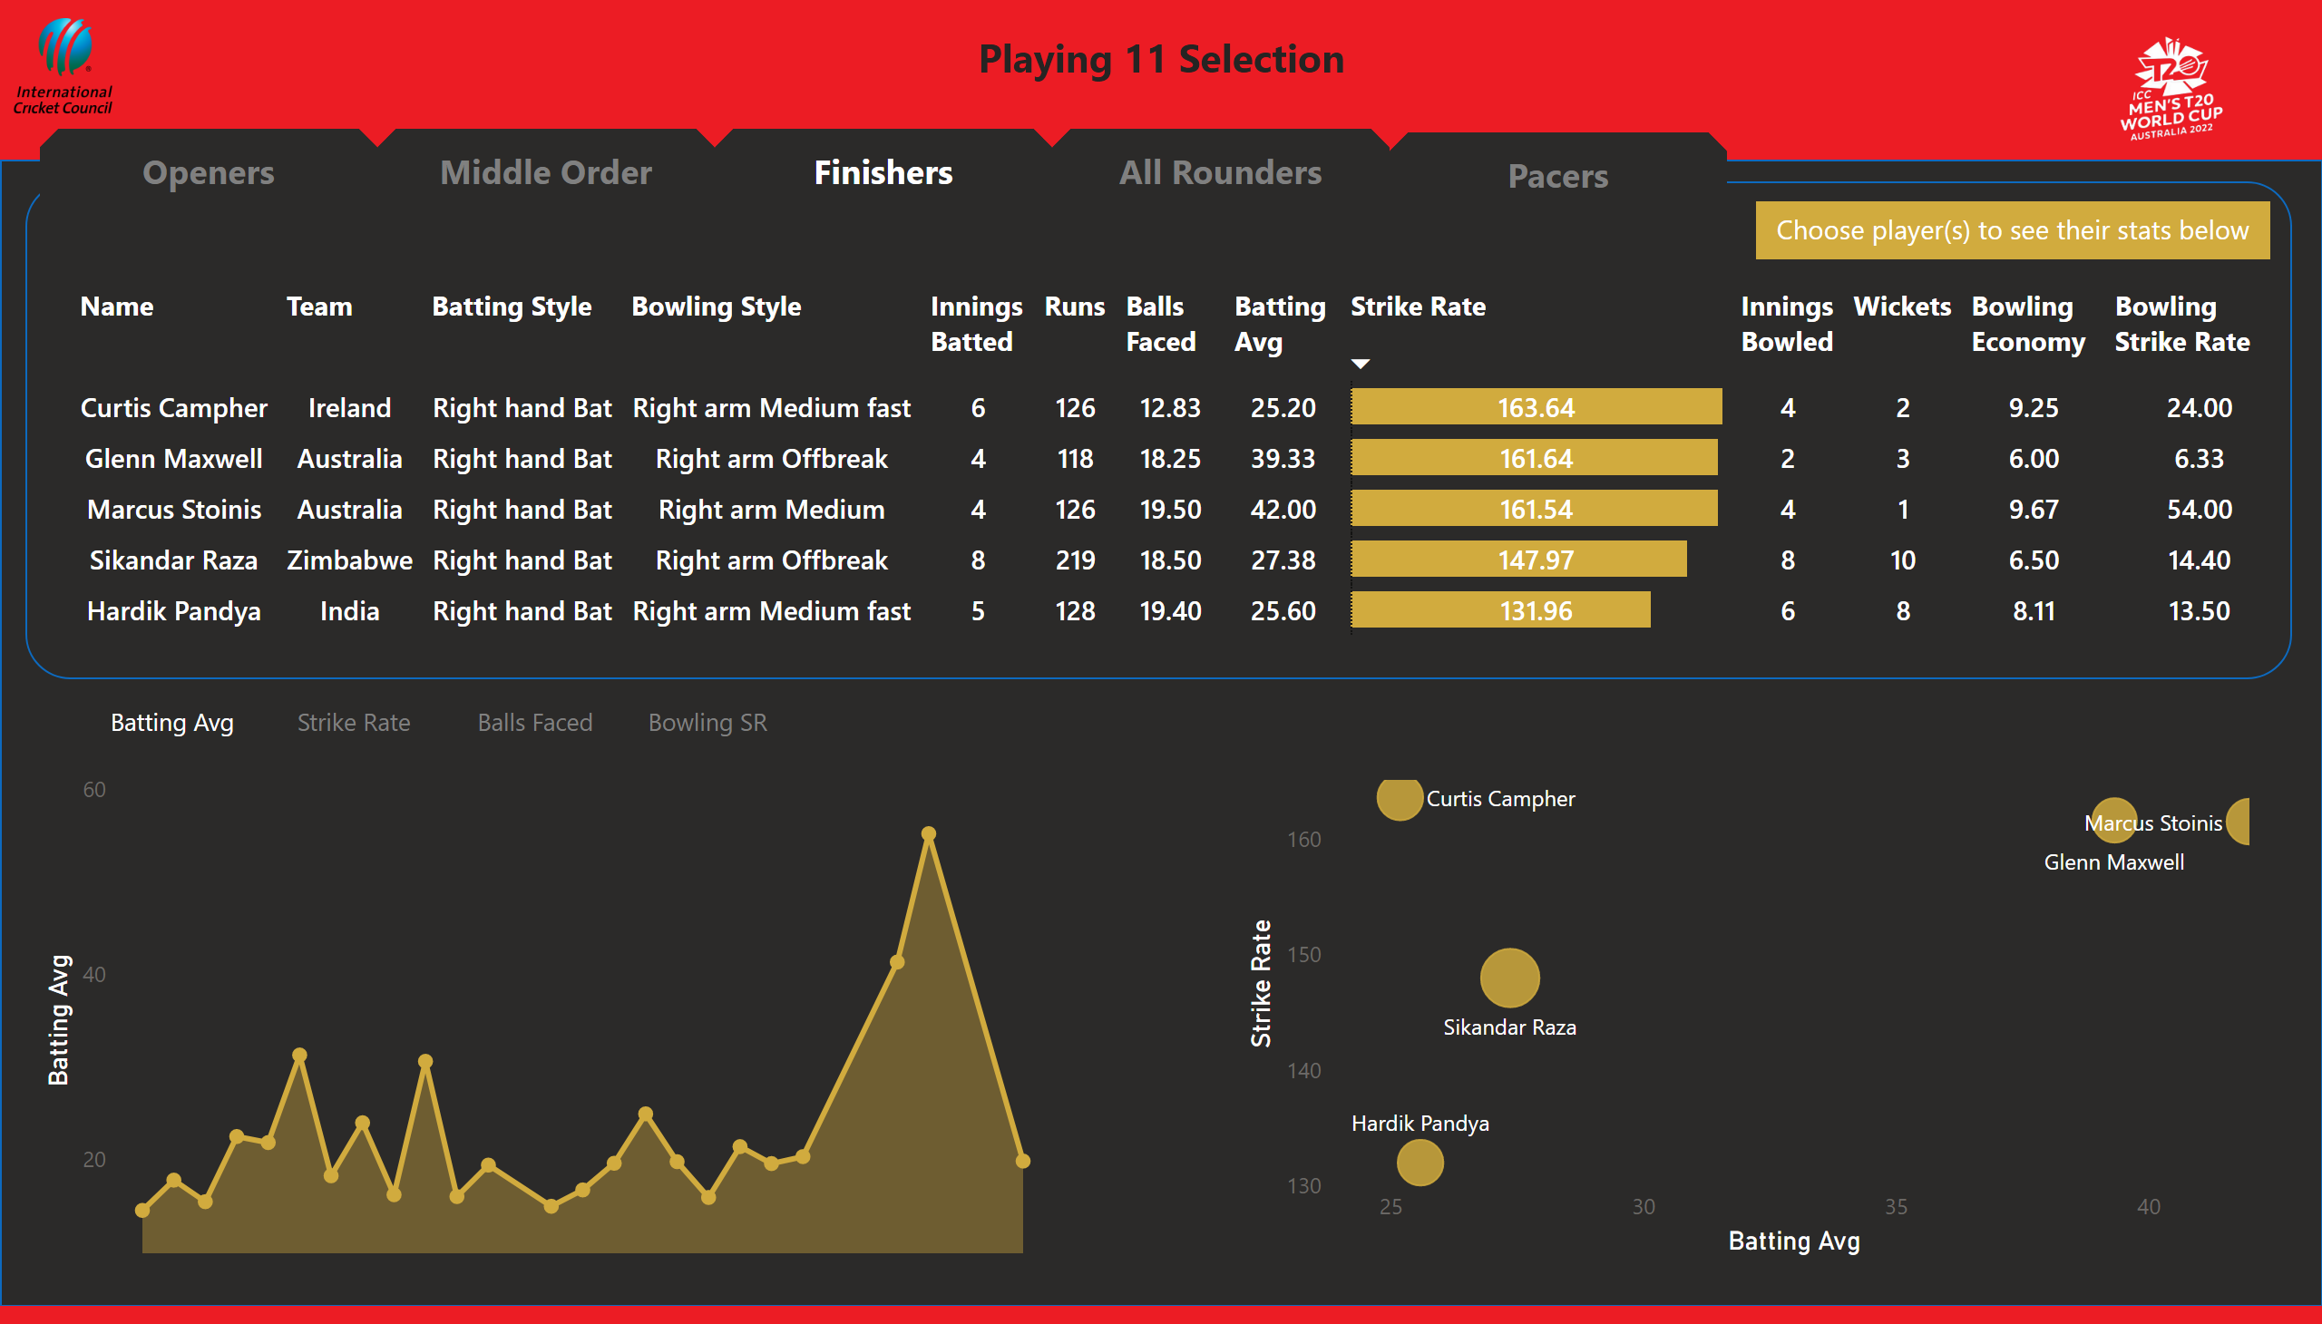
Finisher
Notes:
tableEx
No alt text provided
scatterChart
No alt text provided
Batting Avg
No alt text provided
areaChart
No alt text provided
areaChart
No alt text provided
areaChart
No alt text provided
shape
No alt text provided
shape
No alt text provided
actionButton
No alt text provided
actionButton
No alt text provided
actionButton
No alt text provided
actionButton
No alt text provided
actionButton
No alt text provided
Batting Avg
No alt text provided
actionButton
No alt text provided
actionButton
No alt text provided
actionButton
No alt text provided
Batting Avg
No alt text provided
Strike Rate
No alt text provided
Balls Faced
No alt text provided
Bowling SR
No alt text provided
textbox
No alt text provided
image
No alt text provided
image
No alt text provided
textbox
No alt text provided

Slide 5
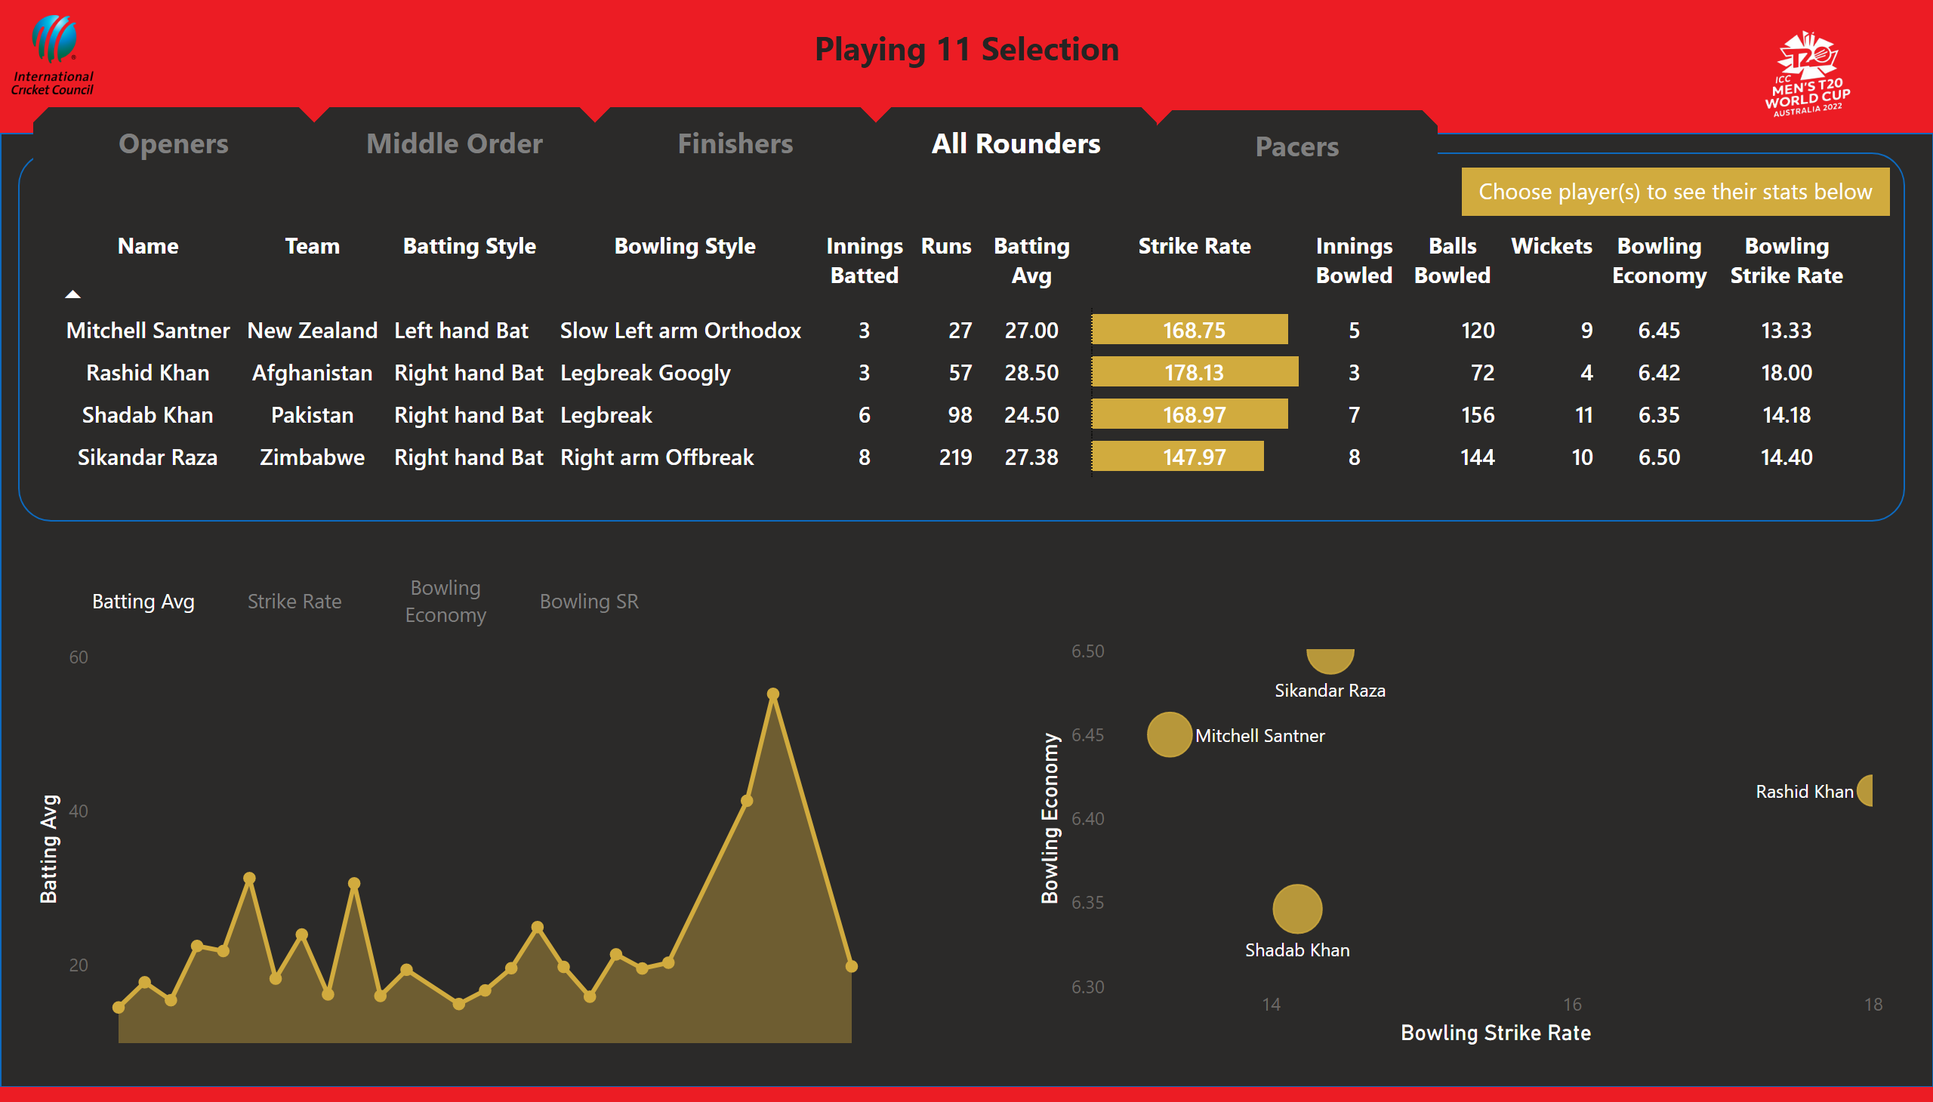
All Rounders
Notes:
tableEx
No alt text provided
Bowling Strike Rate, Bowling Economy and Sum of wickets by Name
No alt text provided
Batting Avg
No alt text provided
areaChart
No alt text provided
areaChart
No alt text provided
areaChart
No alt text provided
shape
No alt text provided
shape
No alt text provided
actionButton
No alt text provided
actionButton
No alt text provided
actionButton
No alt text provided
actionButton
No alt text provided
actionButton
No alt text provided
textbox
No alt text provided
Batting Avg
No alt text provided
actionButton
No alt text provided
actionButton
No alt text provided
actionButton
No alt text provided
Batting Avg
No alt text provided
Strike Rate
No alt text provided
Bowling Economy
No alt text provided
Bowling SR
No alt text provided
image
No alt text provided
image
No alt text provided
textbox
No alt text provided

Slide 6
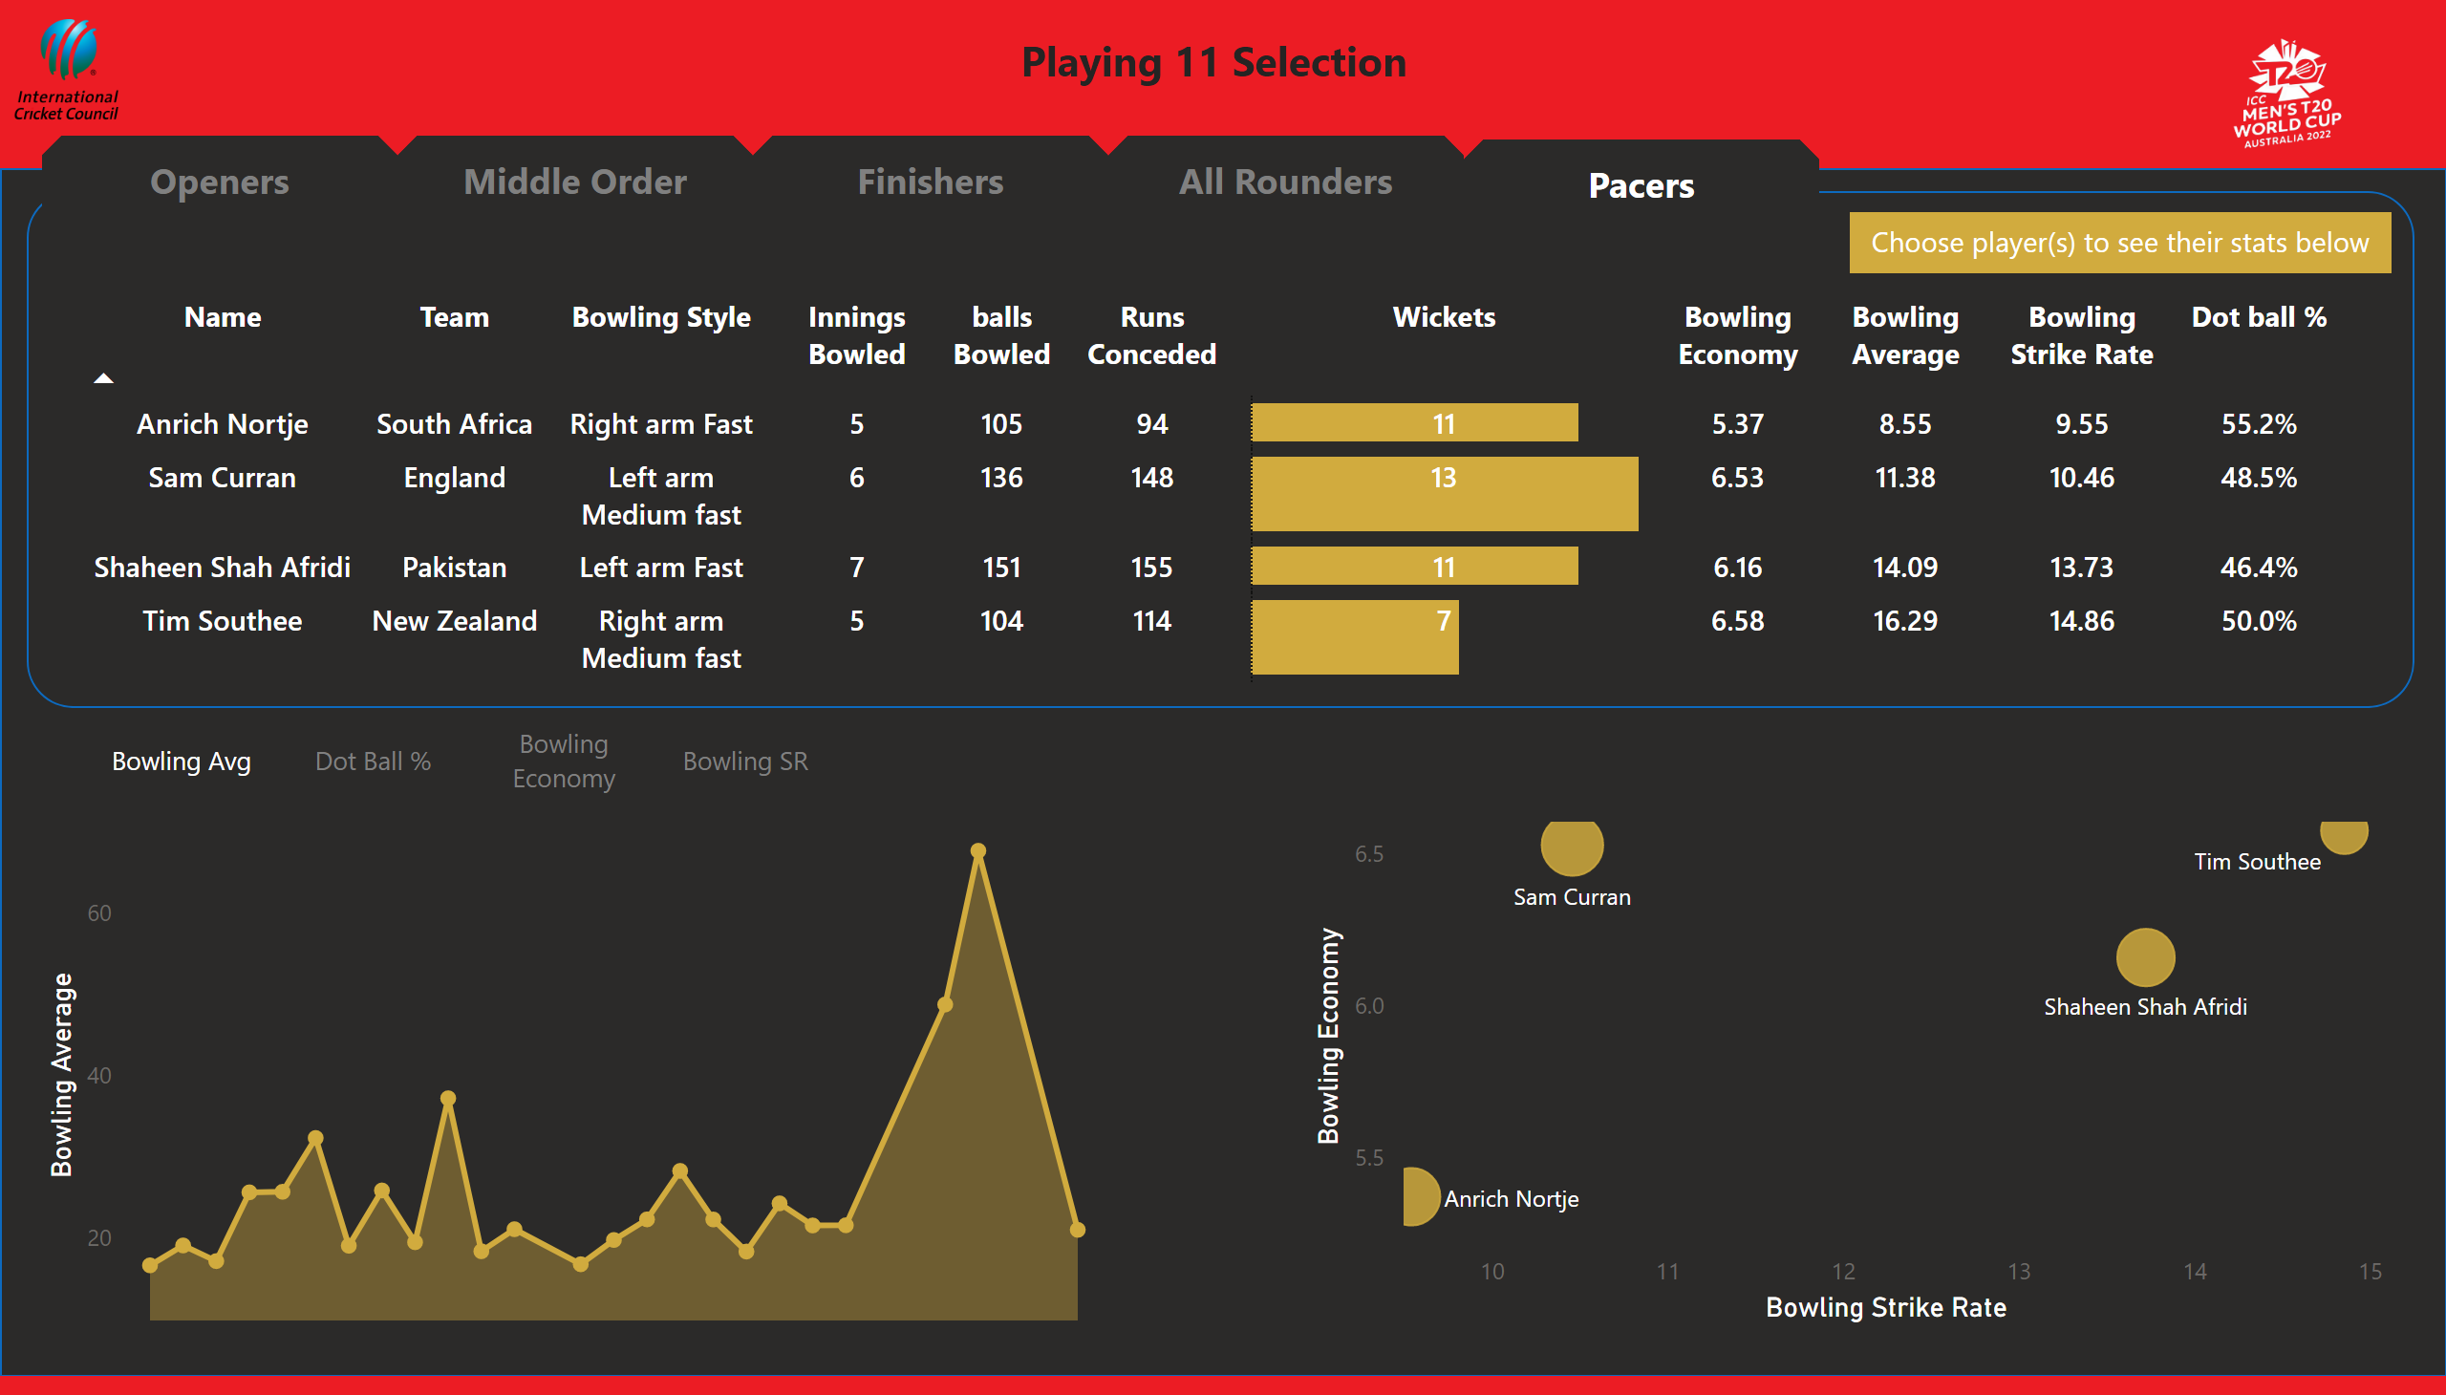
Specialist Pacers
Notes:
tableEx
No alt text provided
scatterChart
No alt text provided
Bowling Average
No alt text provided
areaChart
No alt text provided
areaChart
No alt text provided
areaChart
No alt text provided
shape
No alt text provided
shape
No alt text provided
actionButton
No alt text provided
actionButton
No alt text provided
actionButton
No alt text provided
actionButton
No alt text provided
actionButton
No alt text provided
textbox
No alt text provided
Bowling Avg
No alt text provided
actionButton
No alt text provided
actionButton
No alt text provided
actionButton
No alt text provided
Bowling Avg
No alt text provided
Dot Ball %
No alt text provided
Bowling Economy
No alt text provided
Bowling SR
No alt text provided
image
No alt text provided
image
No alt text provided
textbox
No alt text provided

